Slide 1
Selenium Automation

Slide 2
Overview
Why Automation?
Why selenium for Automation?
Features
Framework
Utility library
Page objects
Tests
Test Report
Maven Integration

Slide 3
Why Automation?
Reduce the time to run regression tests
Increase the effectiveness, efficiency and coverage
Reduce rework of testing

Slide 4
Why selenium for Automation?
Open-source software
License: Apache License 2.0
Cross-platform compatibility
Windows, Linux, and Macintosh
Cross Browser compatibility
Google Chrome, IE, Firefox, Safari, Opera, HtmlUnit etc.
Record and playback tests

Slide 5
Features
Allows scripting in several languages like Java, C#, PHP and Python
Provide efficient way of comparing expected and actual results
Support different method to locate Web Elements
Inbuilt reporting mechanism

Slide 6
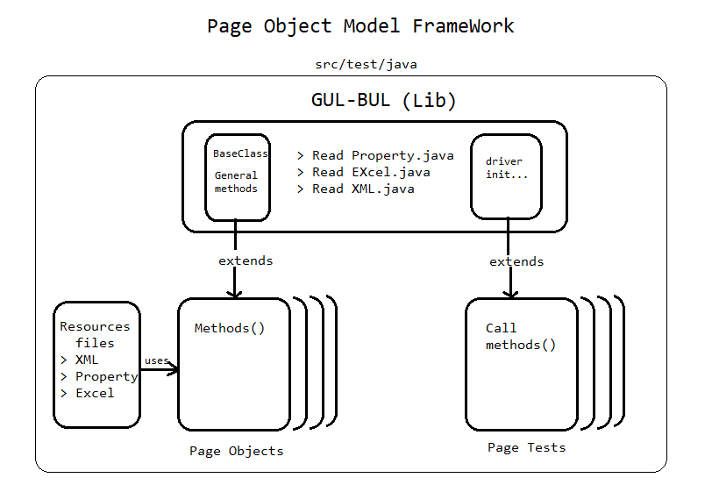
Framework (AFIS)

Slide 7
Framework Details
Web elements are located in property files
Easy to maintain
Provide isolation from code
Test data support in Excel file
Reduce code repetition by using libraries
Provide code isolation for each page using page objects

Slide 8
Utility library
GUL(general utility libraries)
Base class(reusable methods)
Read Excel Class
Read Properties Class
Read XML Class
BUL(business utility libraries)
Properties file
Excel data
XML data

Slide 9
Page objects
Each web page is identified as a Page Object
Page Object is a java class file
Contains methods to perform different action on that page
Entering Text into field
Click Link/button
Validate messages etc.

Slide 10
Test Script
Test Script perform different validations and verifications on each Webpage
Validate Link functionality
Validate Button Functionality
Verify Messages

Slide 11
Test Report
TestNG reports
Html report
XML report
ReportNG reports
It is a plug-in for the TestNG
Provide simple, color-coded view of the test results.

Slide 12


